Slide 1
Façade Pattern
By
Narendran, S S

Slide 2
Key Items
Decoupling
Java Then and Now.
API designs
Subsystem independence and portability
Façade in Layered Architecture

Slide 3
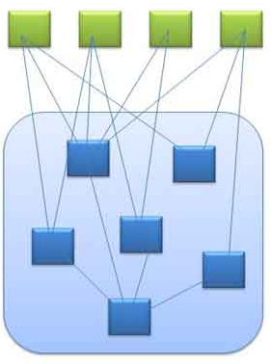
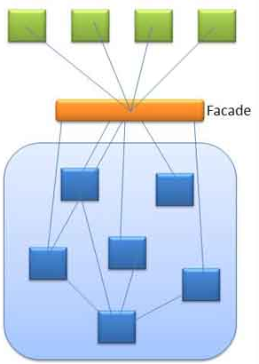
Façade Pattern
A facade or façade is generally one exterior side of abuilding, usually, but not always, the front. The word comes from the French language, literally meaning "frontage" or "face".
A facade is an object that provides a simplified interface to a larger body of code, such as a class library.
Notes:
Front Controller is a good Example, but all Controllers are not façade.

Slide 4
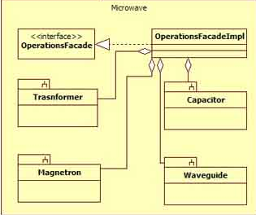
Façade Pattern - UML

Slide 5
Pros and Cons
Pros
Façade is Client (Programmer) Oriented. It simplifies the Client View when the Technical complexity and no. of individual modules are very high let out for Clients usage.
Façade design pattern is used for promoting subsystem independence and portability.
Subsystem may be dependent with one another. In such case, facade can act as a coordinator and decouple the dependencies between the subsystems.
Translating data to suit the interface of a subsystem is done by the facade. (API systems)
Cons
Sometimes Façade is forced – Which should not be.
Many times it is misunderstood as a layer.
Façades make the easy stuff easy; for the hard stuff, you must delve into the subsystem itself.

Slide 6
What is not a Façade?
just for the sake of introducing a facade layer developers tend to create additional classes. Layered architecture is good but assess the need for every layer. Just naming a class as ABCDFacade.java doesn't really make it a facade.
Creating a java class and ‘forcing’ the UI to interact with other layers through it and calling it a facade layer is one more popular mistake. Facade layer should not be forced and its always optional. If the client wishes to interact with components directly it should be allowed to bypass the facade layer.
Methods in facade layer has only one or two lines which calls the other components. If facade is going to be so simple it invalidates its purpose and clients can directly do that by themselves.
A controller is not a facade.
Facade is ‘not’ a layer that imposes security and hides important data and implementation.
Don’t create a facade layer in advance. If you feel that in future the subsystem is going to evolve and become complicated to defend that do not create a stub class and name it a facade. After the subsystem has become complex you can implement the facade design pattern.
Subsystems are not aware of facade and there should be no reference for facade in subsystems.

Slide 7
References
http://javapapers.com/design-patterns/facade-design-pattern/
http://www.javaworld.com/javaworld/jw-05-2003/jw-0530-designpatterns.html
http://userpages.umbc.edu/~tarr/dp/lectures/Facade.pdf

